Slide 1
Progress on the Industrial Use Cases
Model Writer

Slide 2
WP1 overview
3 main use cases:
Airbus | Regulation documentation & Design rule repository
Havelsan | Requirement and ALM tool
Ford Otosan | Design specification with CAD (FEAD, GDR)
Project Review 1 Conclusions and Actions 2015:
Focus on the most rewarding use cases with the best exploitation prospects
Decrease MW ambition: reduce the effort on UC and put the effort on technical work packages

Slide 3
AIRBUS industrial use cases
Anne MONCEAUX
AIRBUS GROUP INNOVATIONS

Slide 4
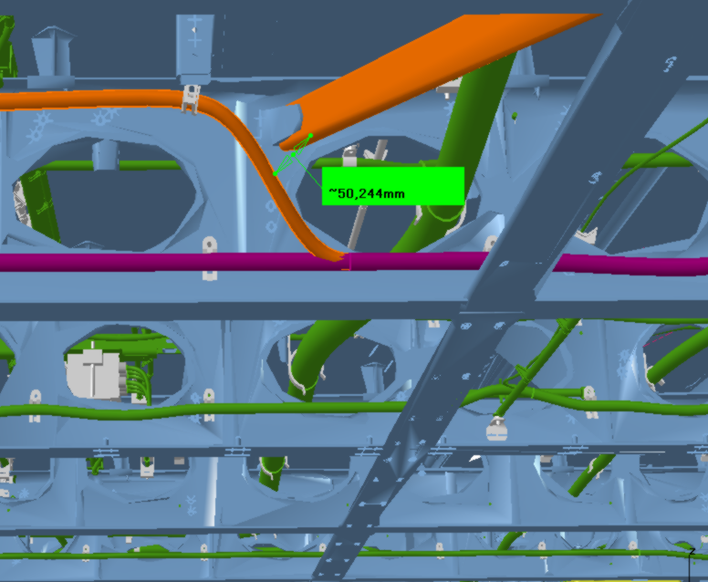
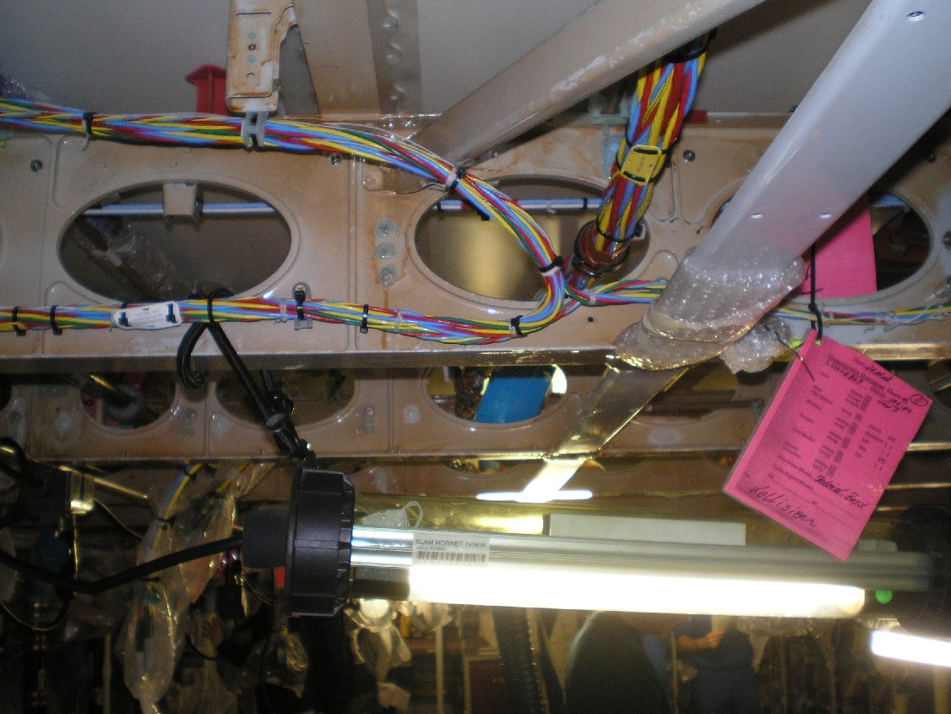
Airbus use cases in ModelWriter
We decided to concentrate on some problematics related to System Installation
SIDP is used (under Non Disclosure agreement) as a use case
We primarily focus on Electrical, Water Waste, and Fuel Systems
System installation:
obeys to some Regulations
is specified by some rules/requirements/principles
the design and the manufactured product are checked against these rules

Slide 5
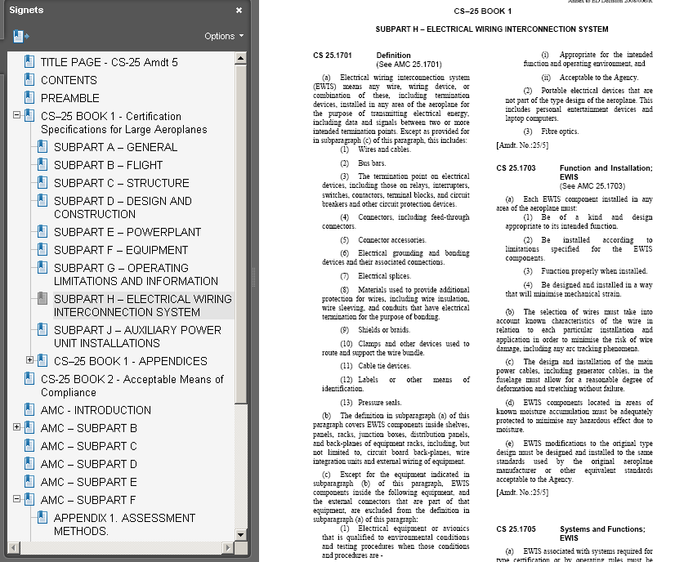
Certification Specification – CS 25 (EASA)
CS 25.1701 Definition
(a) Electrical wiring interconnection system (EWIS) means any wire, wiring device, or combination of these, including termination devices, installed in any area of the aeroplane for the purpose of transmitting electrical energy, including data and signals between two or more intended termination points (...)

Slide 6
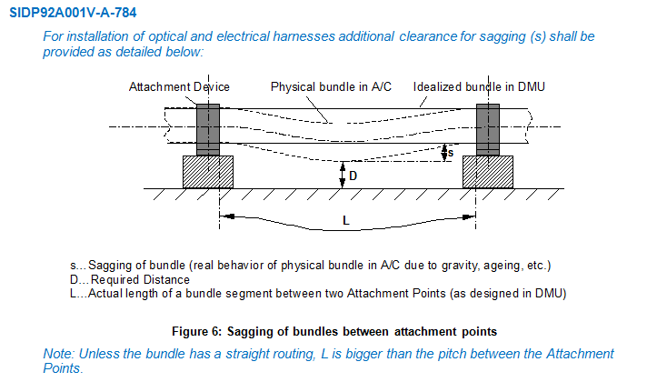
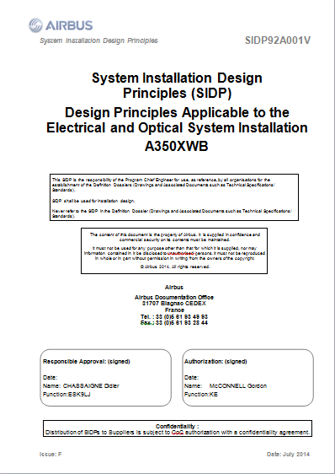
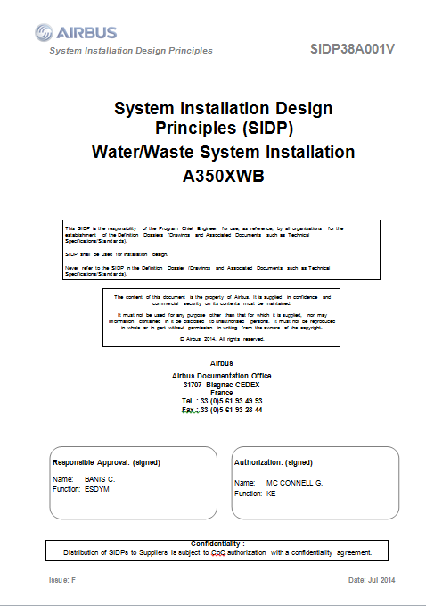
System Installation Design Principles

Slide 7
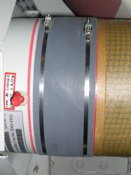
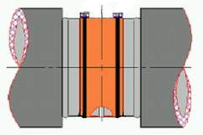
Rule traceability & design check
Traceability
Check

Slide 8
Problem statement & objectives
Model and manage the design rules: since SIDP (design principles) are todays kinds of natural language requirements and explanations:
not all the rules can be directly formalized in a way to be used to verify the design
rules are spread over various products/programs
rules evolve
rules are complex artefacts made of text and picture and tables….
This problem is the one we have been considering primarily in the scope of ModelWriter, trying to define a rule model and knowledge base
Enable mapping between rule model and design model, in order to automate identification of conflicts between rules and design, and then automate analysis of the impact of changes in rules or in design.
This 2d objective is not a primary one for Airbus in ModelWriter because of the challenge of mapping 3D design models to the BOM… and because lack of skills and data in the context of the project
BUT to be consider to make the system amenable for formal analysis / & we welcome Ford Otosan Use case

Slide 9
Problem statement & objectives
(1) Manage rules/design principles and improve traceability
Easier search/retrieval of rules | save costs/time by supporting DP consultation / retrieval in accordance to the needs
Easier change impact analysis at rules level | save DP updating costs/time avoid non-compliance of design caused by DP updating lead time
Easier traceability between artefacts (BOM DB, design models, CAD models…) | keep traceability from upstream regulations to requirements and to downstream design models
(2) Automate identification of design conflicts against rules
Easier consistency checking of the design (CAD) data | Save time to retrieve applicable rules avoid non-compliance of design wrt rules

Slide 10
Solutions explored in MW
 |  | 1 | 2 | 3 | 4
Use a Component taxonomy (~BOM) as a reference to annotate rules (rules as Text part / Taxonomy as Model part) | MW synch. mechanism + Semantic Annotation tool (WP2+WP4) | + | + | - | -
Extend first approach to annotate other artefacts/models | MW synch. mechanism + Semantic Annotation tool (WP2+WP3+WP4) | + | - | + | +
Add semantics to Component description (ontology) to enable reasoning | MW synch. mechanism + reasoning mechanisms dedicated to synchronization (WP4+WP3) | + | + | +
Model rules written in natural language by formalizing them in Description Logic and vice versa / Ability to dynamically update the Component ontology and apply some checks on design rules | MW synch. mechanism + Semantic parsing/DL generation (WP4+WP2) |  | + | + | +
Model rules written in natural language by formalizing the rules in relational logic | MW synch. mechanism + MW model (WP4+WP3) |  |  | + | +
1=Rule retrieval, 2=Rule change, 3= Traceability, 4=Design check

Slide 11
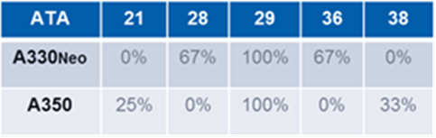
Some Facts, Impact, and KPIs
Scope of 900 documents
ATA : disciplines: 6179 ATA number (chapter+subchapters)
Today (@MW project start) duration of documents updating process: ~ 6 months
900 to 1000 potential users per Program or 200 per Derivatives
Total number of rules? ~3000 rules (TBC)
Expected Rule coverage in the use cases? ~50%
966 rewritten rules (quality to be checked)
Coming from 7 different SIDP docs (SIDP 92 is missing in the table below that shows the coverage of rewritten rules wrt to SIDP docs)

Slide 12
Back-up Slides
UC-FR-03 - Synchronization of Regulation Documentation with a Design Rule Repository
Anne MONCEAUX
Airbus Group Innovation

Slide 13
Rule data representation
Object Property
RUID
Rule
Component
RuleID
Rule primary object
Variant
SubClasses
…
coupling
equipment
others
Data Properties
Classes

Slide 14
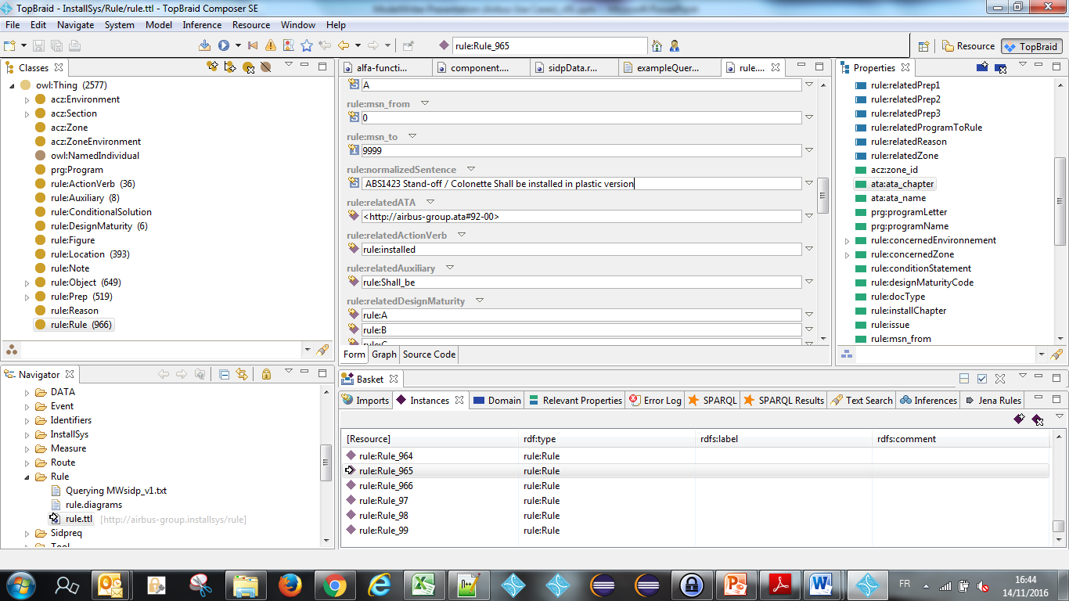
Rules (DB with normalized sentences)

Slide 15
BOM, Component taxonomy and ontology
ObjectProperties
Component
Assembly
“Structural_Element”
subClassOf
“Bracket”
Physical component
Attachment device
“Fastener”
“Pclamp”
Clamp
AnnotationProperties
Rdfs:label
“Assembly”
Skos:prefLabel
P-Clamp
P-Clamp NSA5516

Slide 16
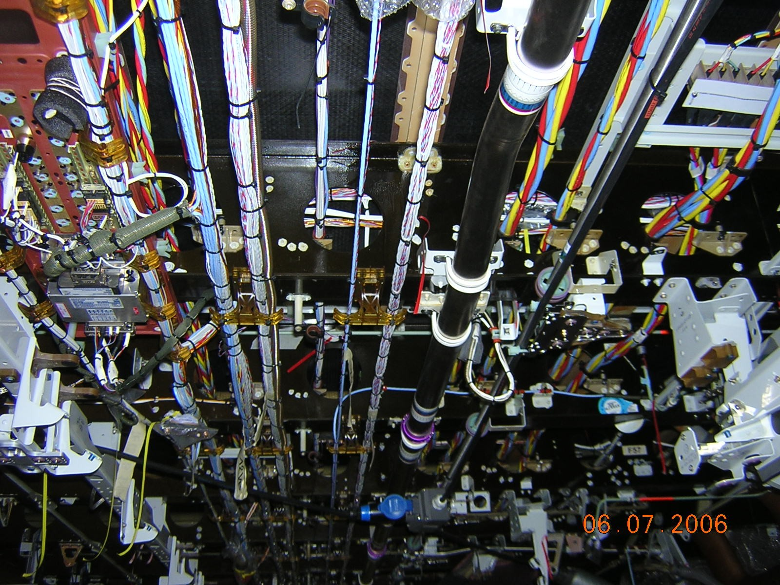
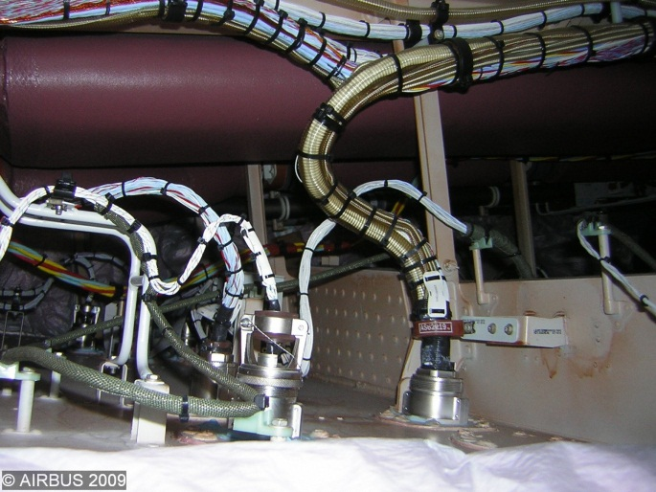
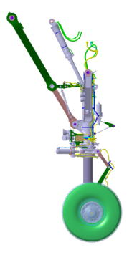
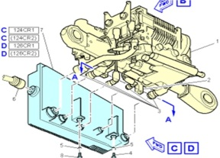
Ex. Electrical wiring interconnection system (EWIS)
Mainly: Aircraft electrical common installation (ATA92)
1
3
11
12
6
8
4, 5
10
13
But also: part of Systems equipment wiring:
Power distribution centers wiring
External wiring of equipment
Wiring of equipment not qualified to appropriate standards e.g. EUROCAE ED-14 / RTCA DO-160
cf CS 25.1701(b)&(c)

Slide 17
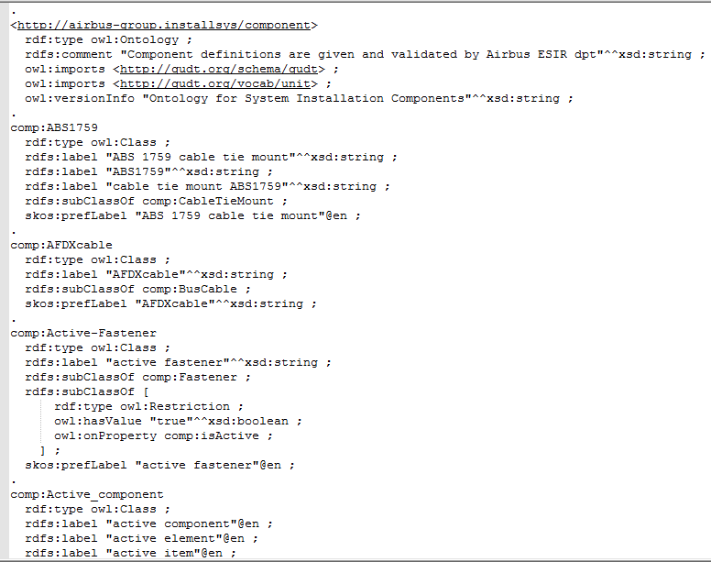
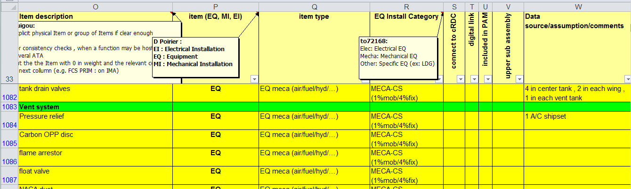
BOM, Component taxonomy and ontology

Slide 18
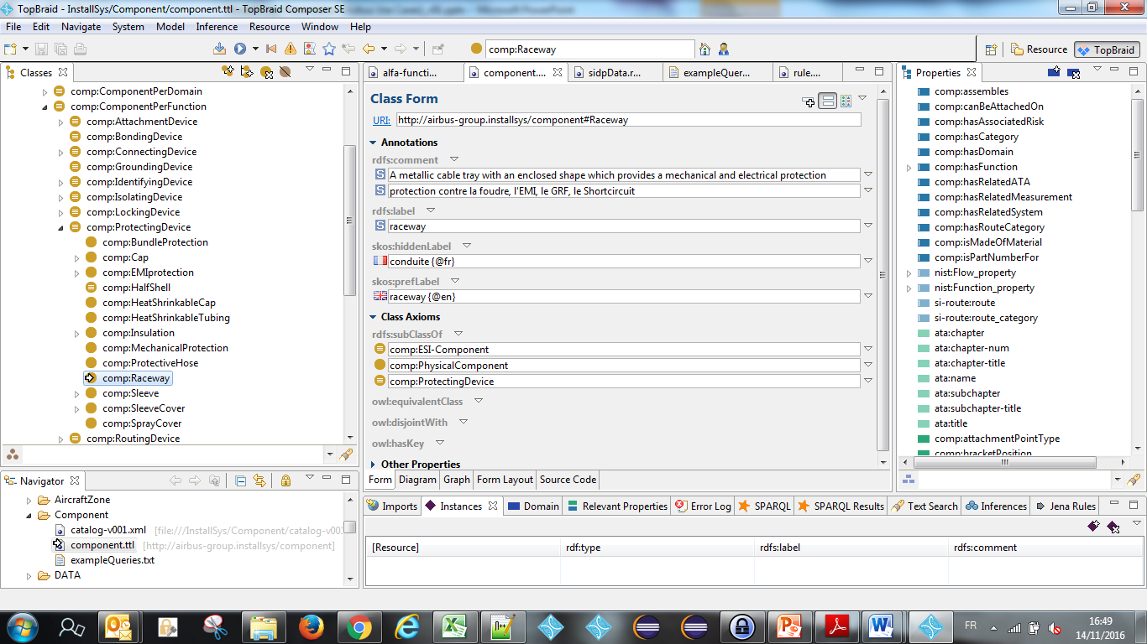
Component ontology

Slide 19
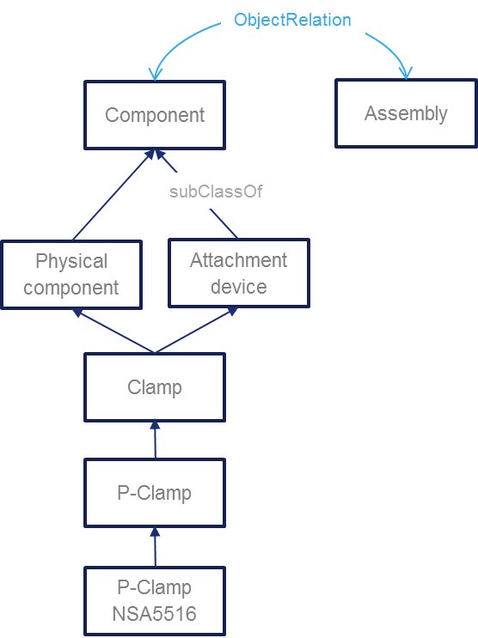
UC-FR-04 - Component taxonomy and ontology (Model part)
“P-clamp NSA5516 can be fixed on X with Y”
“Physical component”
“Standard reference”
NLP Parsing uses this taxonomy. Labels + assumptions such as a physical component may be referred to using its name or its reference or both concatenated
Inference rule: a rule applying to a component type (Attachment device) applies to its subtypes (P-clamp)
Document display : when searching rules applying to a component type (P-Camp) → retrieve and display rules applying to super-types

Slide 20
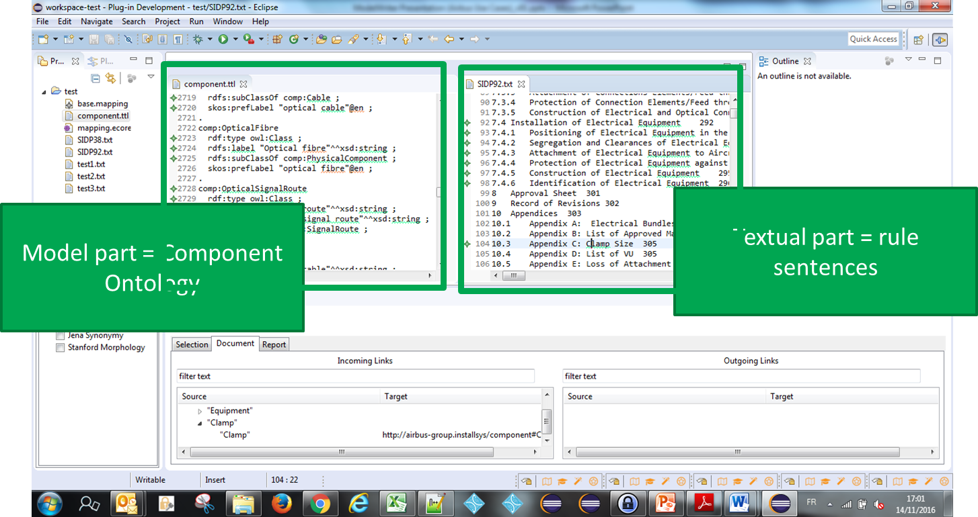
On going tests = Use a Component taxonomy (~BOM) as a reference to annotate rules (rules as Text part / Taxonomy as Model part) - WP2+WP4 Core
Status 1st iteration*: synchronizing the SIDP KB content and rule text part
Experimented using WP2 parser + WP4 MW Core
1st iteration = using individual DP normalized sentences”
2d iteration = using NL DP inside documents
*

Slide 21
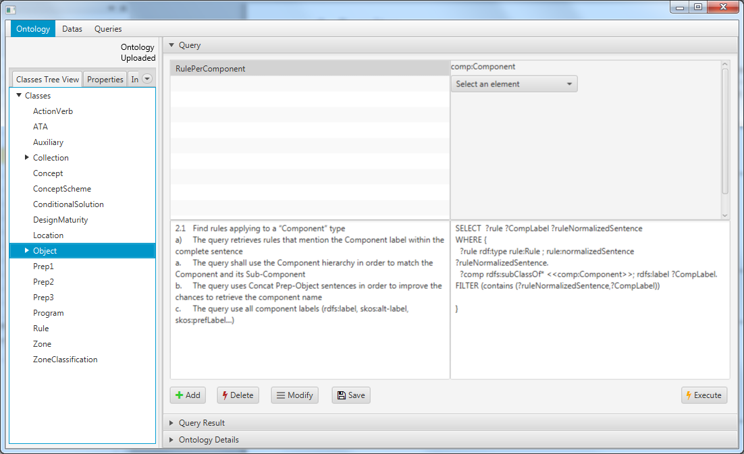
SPARQL queries
Status : model based queries specification
Preliminary study with Loria (Text to RDF)
1 internship on RDFizer and Query management

Slide 22
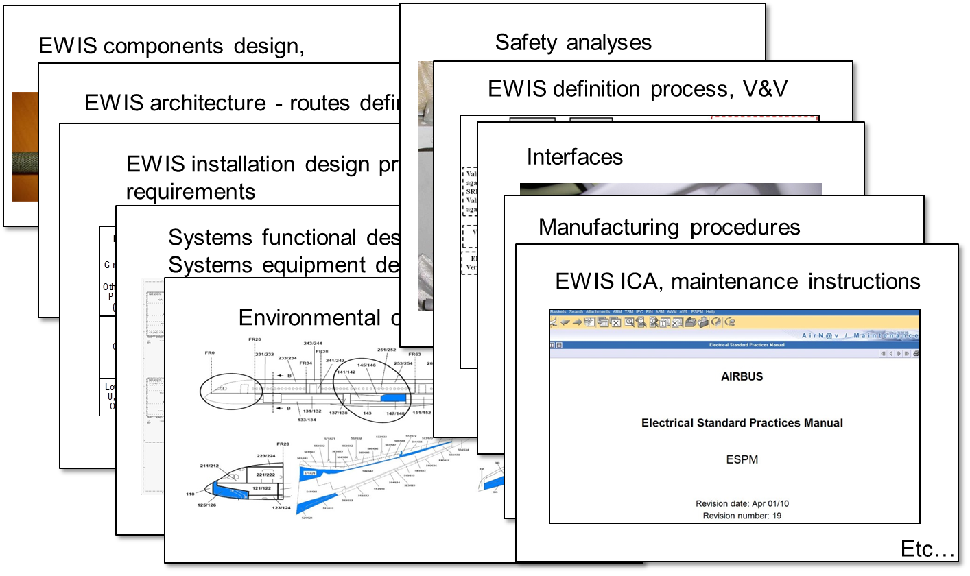
Ex. A/C wiring - Traceability with other artefacts

Slide 23
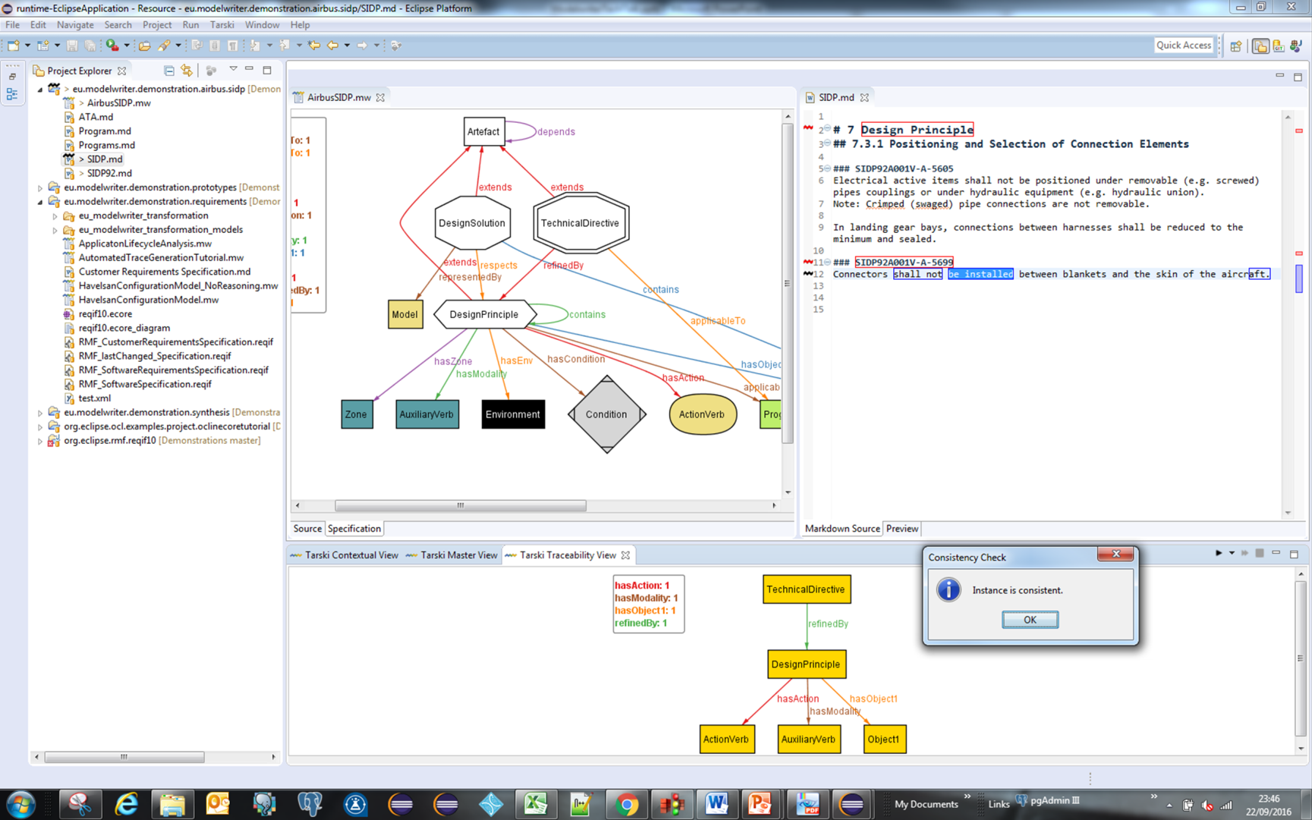
On going tests = Extend first approach to annotate other artefacts/models and reason about them - WP2+WP3+WP4 Core
Status : synchronizing the SIDP domain artefacts
Test using WP3 Tarsky
Model part = SIDP traceability model
Textual part = DP NL text in documents
*

Slide 24
Thank you for your attention! Any question ?

